Slide 1
OpenStack QA
May 2019
Project Update, OpenStack Summit Denver
Ghanshyam Mann, IRC- gmann, gmann@ghanshyammann.com
Masayuki Igawa, IRC- masayukig masayuki@igawa.io

Slide 2

Notes:
Insert Mascot right

Slide 3

What is OpenStack QA??
Official Mission Statement:
“Develop, maintain, and initiate tools and plans to ensure the upstream stability and quality of OpenStack, and its release readiness at any point during the release cycle.”
Notes:
Insert Mascot right

Slide 4

What is OpenStack QA??
Test Runners
Dev & Test environment
Test Frameworks
stestr
os-testr
Devstack
Tempest
devstack-tools
Tempest plugin interface
os-performance-tools
devstack-vagrant
devstack-plugin-cookiecutter
karma-subunit-reporter
tempest-plugin-cookiecutter
tempest-lib (Deprecated)
Grenade
devstack-plugin-ceph
Grenade plugin interface
devstack-plugin-container
Patrole
Devstack plugin interface
tempest-stress
Test Results
Syntax Checks
openstack-health
Hacking
Stackviz
bashate
coverage2sql
eslint-config-openstack
https://governance.openstack.org/tc/reference/projects/quality-assurance.html

Slide 5
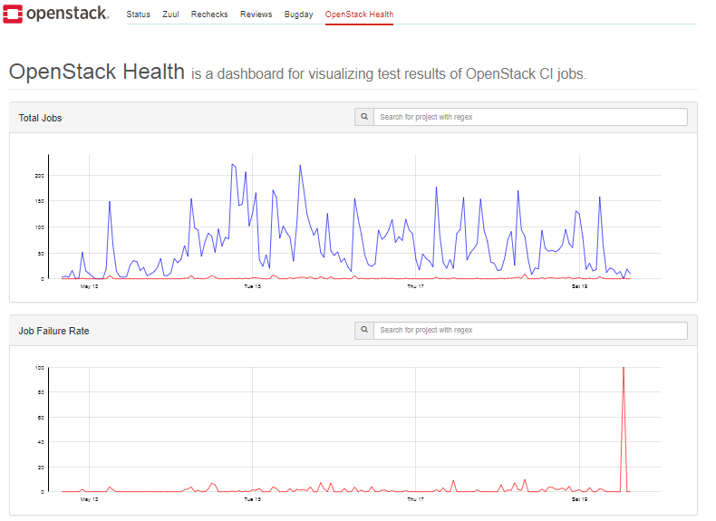
What is OpenStack QA??
Things we do:
Community driven approach to QA
Serve the OpenStack community
Drive testing best practices
Maintain test tools and frameworks
Keep the gate running smoothly
Support interoperability testing efforts
Cross Community collaboration on testing tools etc
Open for new testing ideas/projects
Notes:
Insert Mascot right

Slide 6
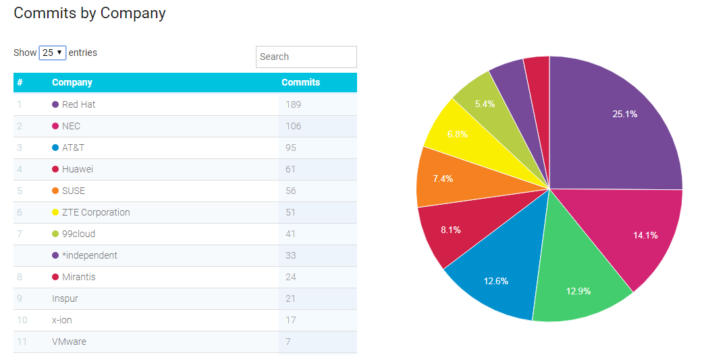
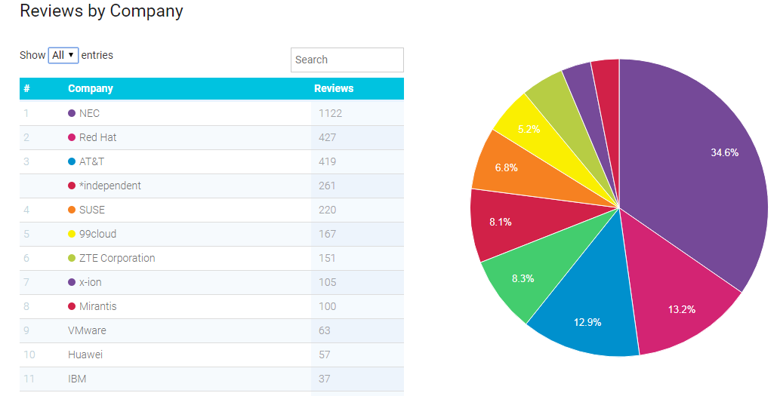
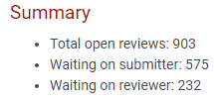
QA CONTRIBUTION STATS: (Stein Cycle)
https://www.stackalytics.com/?module=quality%20assurance-group&metric=marks&release=stein
Commits: Total 753 (Rocky 497) Reviews: Total 3242 (Rocky-2159) Bugs
Filed Bugs: 175
Resolve Bugs: 77
Open Change Request
Notes:
Insert Mascot right

Slide 7
OpenStack Stein Features
Devstack
Devstack base jobs switched to Ubuntu Bionic
Testing gate with shared network env
Base job for IPv6 and fixes bug for IPv6.
Bug fixes etc
Tempest
Tempest CLI testing improvement
Proper handling of interface/volume/pci device attach/detach hotplug/unplug
API Microversion schema gap testing,
Placement service client support,
Tempest multinode jobs working for stable branches.
Immutable user source support.

Slide 8
OpenStack Stein Features
Patrole:
More neutron policy tests coverage.
Documentation Improvements
Misc updates for stable release of Patrole.
Other projects are going with usual bug fix and minor support updates.
Migration of OpenStack gate testing from Ubuntu Xenial(16.04) to Bionic(18.04)

Slide 9
OpenStack Train
New:
Finish Zuul v3 native jobs for grenade
Patrole stable release
Keystone system scope testing support in Tempest & Devstack along with gate job setup
Volume strict validation testing using JSON schema
Support k8s installation in devstack-plugin-container
Stability:
Making integrated-gate jobs like tempest-full more stable
More documentation and guidelines for Tempest plugins
Consuming all Tempest CLI in gate
Make scenario manager stable for plugins
Tempest smart cleanup feature
Keep gate stable.

Slide 10
Beyond Train
RBAC testing on gate using Patrole
Strict validation testing using JSON schema for more projects

Slide 11
Cross-Project Work
Zuulv3 migration for grenade jobs
Plugins help on fixing the usage and guidelines
Integrated-gate jobs more stable
Support the OpenStack CI/CD platform updates.

Slide 12
How to give feedback
Report Bug
Bug Tracking links - https://wiki.openstack.org/wiki/QA
Send mail on ML: openstack-discuss@lists.openstack.org with [qa] in subject
Ping on IRC. #openstack-qa
Forum session:
Users / Operators Feedback on QA
QA Onboarding sessions

Slide 13
How to contribute
Tomorrow: QA Onboarding sessions, Wednesday, May 1, 9:00am-9:40am The Colorado Convention Center - 406
Join us in #openstack-qa, Freenode IRC.
PTG: OpenStack QA Room 105 @PTG May 2-3, 2019
- https://etherpad.openstack.org/p/qa-train-ptg
OpenStack Contributor Guide.

Slide 14
Q&A
Thank you!
openstack
openstack
OpenStackFoundation

